Slide 1
Activity: Ping Totumuro
English - 51653

Slide 2
Text
Ping Totumuro is a 35-year-old painter from Japan. He has a beautiful house in Kyoto, Japan. He lives with his two big goldfish, Ying and Yang. He is now divorced and doesn’t have many friends. His parents live in Tokyo with his sister Levan, a 25-year-old architect who works for an important construction company. On weekends, Ping usually visits his parents and his sister and goes back to his house on Monday.

Slide 3


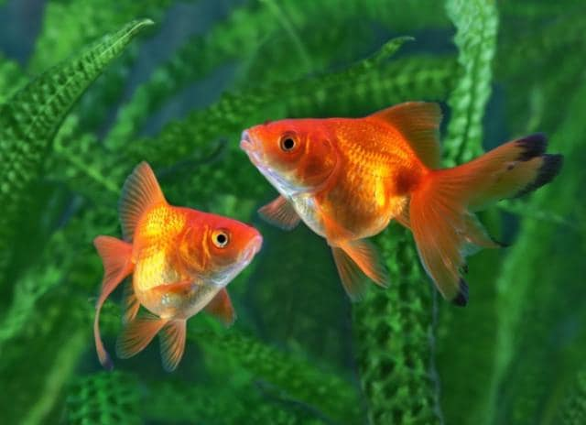
Information
Ping Totumuro is 35 years old.
He is a painter.
He is from Japan.
He lives in Tokyo.
He has a beautiful house.
He lives with his pets.
He has two big goldfish.
The names of his pets are Ying and Yang.

Slide 4



Information
He is divorced.
Ha doesn’t have many friends.
His parents live in Tokyo.
His sister Levan lives with her parents.
She is a 25 years old architect.
She works for an important construction company.
Ping usually goes out on weekends.
Ping usually visits his parents.

Slide 5

Information
Ping usually visits his sister.
In the weekends, when he is in his parents house, he goes back to home on Mondays.

Slide 6
Complete the sentences
According to the text, Ping’s sister lives with her parents.
Ying and Yang are two big goldfish.
Ping’s sister is architect. Her constructions are very resistant.
Levan Totumuro is 10 years older than her brother Ping.
On weekends, Ping goes to his parents house to visits his family.

Slide 7
Thanks for watching
Alejandro Giraldo Herrera, 09/06/2021

